Slide 1
Climate Change Impact on Crop Yield: A Data-Driven Approach
By Gopalakrishnan Kumar, MTech IIT-Bombay,
Math AI Trainer, Outlier AI , Freelance Data Science Consultant
LinkedIn: Profile Link : https://www.linkedin.com/in/gopalakrishnankumar-a73301110/
Github:https://www.github.com/Gopalakrishnan-Kumar/
Kaggle URL- https://www.kaggle.com/gopalkk2

Slide 2
Google Colab
https://colab.research.google.com/drive/1o0Jo3hvVttSgrbEz9yt78rfIeiASViAn?usp=sharing

Slide 3
Introduction
Climate change is one of the most pressing global issues today, significantly impacting agriculture, food security, and rural livelihoods. Changes in temperature, rainfall patterns, and CO₂ concentrations can directly affect the yield of essential crops. This project uses synthetic climate and crop yield data to demonstrate how data science techniques can uncover the relationship between climate variables and crop productivity.

Slide 4
Objectives
Analyze the impact of climate variables (temperature, rainfall, CO₂) on crop yield
Use regression modeling to predict yield based on environmental conditions
Visualize climate trends and their influence using heatmaps and bar charts
Interpret variable importance and correlation patterns

Slide 5
Dataset Description
A synthetic dataset containing 100 records was generated, simulating yearly data from 2000 to 2099. Each record includes:
Column | Description
Year | Year of observation
Temperature | Average annual temperature (°C)
Rainfall | Annual rainfall (mm)
CO₂ | Atmospheric CO₂ concentration (ppm)
Crop_Yield | Crop yield in tons per hectare

Slide 6
Tools & Technologies
Programming Language: Python
Libraries: pandas, matplotlib, seaborn, scikit-learn
Models Used: Linear Regression

Slide 7
Methodology
Data Generation
Synthetic values for temperature (22–30°C), rainfall (400–1200 mm), and CO₂ (370–420 ppm) were generated using random distributions.
Crop yield was computed using a formula incorporating all variables and some noise to simulate natural variance.
Exploratory Data Analysis (EDA)
Climate variables were normalized and plotted using a stacked bar chart to observe yearly changes.
A heatmap was used to visualize correlations between climate variables and crop yield.

Slide 8
Methodology
Modeling & Prediction
Linear Regression was used to model crop yield as a function of climate variables.
Model performance was evaluated using RMSE and R² metrics.

Slide 9
Visualizations
📈 Stacked Bar Chart
Shows how climate variables (Temperature, Rainfall, CO₂) vary year to year.
Helps identify climate trends over time.
🔥 Correlation Heatmap
Shows negative correlation between temperature and yield.
Positive correlation between rainfall and yield.
CO₂ shows a small negative correlation.
Time Series Map

Slide 10
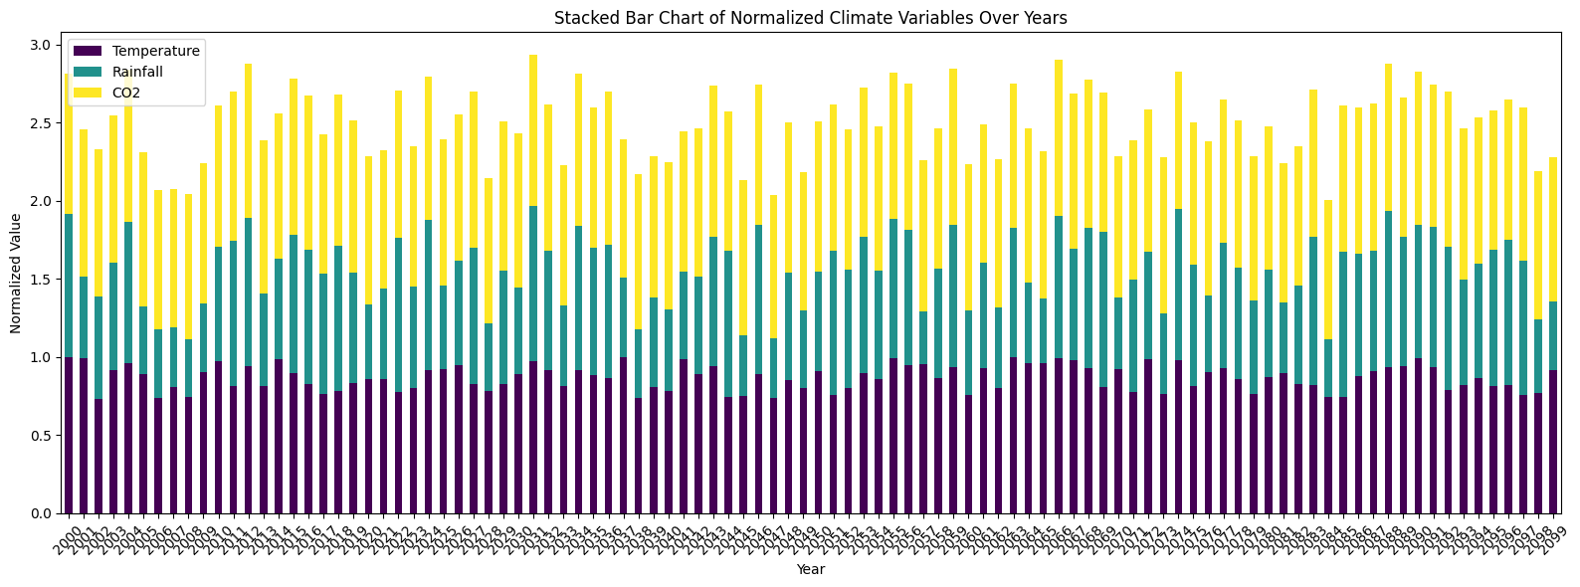
Data Visualization

Slide 11
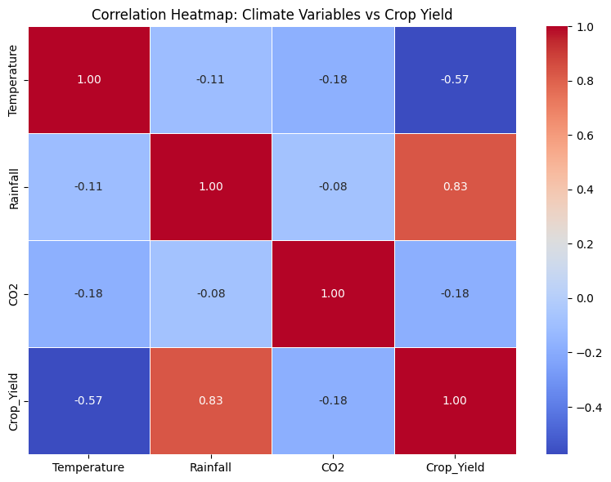
Data Visualization

Slide 12
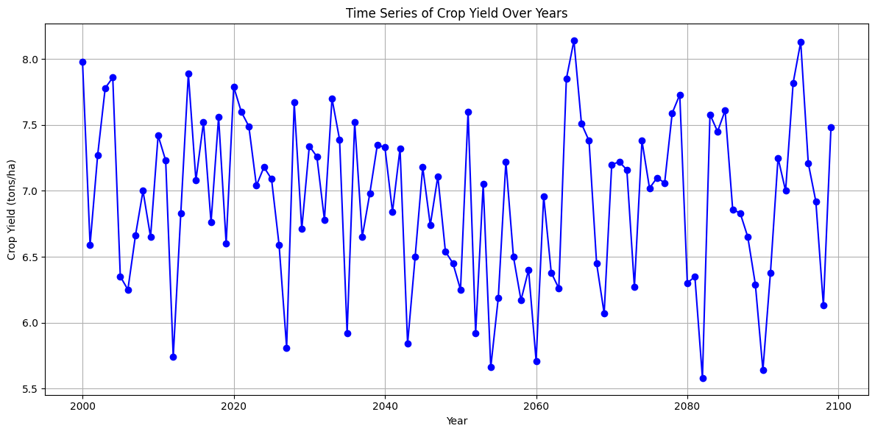
Data Visualization

Slide 13
Key Findings
Higher temperature negatively impacts yield, aligning with known heat stress effects on crops.
Rainfall contributes positively to crop production, indicating its critical role in growth.
CO₂, though often considered a potential yield booster in photosynthesis, may not show strong benefits when other stress factors are present.
The crop yield fluctuates with time.
The Linear Regression Model performed well. The results are as followed-
RMSE = 0.11
R^2 = 0.97

Slide 14
Insights & Recommendations
Climate Resilience: Farmers may need to adopt heat-tolerant crop varieties as temperatures rise.
Water Management: Irrigation planning and water harvesting can mitigate inconsistent rainfall patterns.
Policy Direction: Subsidies for climate-adaptive technologies and awareness programs on sustainable practices can enhance productivity.

Slide 15
Conclusion
This case study shows how data-driven approaches can evaluate and predict the effect of climate change on crop yields. Even with synthetic data, trends reflect real-world phenomena. Incorporating additional variables like soil quality, pest attacks, and fertilizer use could further enhance model accuracy.

Slide 16
Deliverables
📄 This report (available in Word/PDF format)
📊 Visualizations: Stacked bar chart, Heatmap
🧪 Regression model for predicting crop yield
📁 Dataset: crop_climate.csv

